Slide 1
Lesson 2 Robot Operating System (ROS)
AI for Mobile Robots - CSIP5202:
Intelligent Mobile Robotics (IMR)
Dr. Aboozar Taherkhani (PhD)
email: aboozar.taherkhani@dmu.ac.uk

Slide 2
Learning outcomes
Robot Operating System (ROS) Four primary components of ROS:
Nodes
Messages
Topics
Master
Features in ROS Development Environment
Lunch file
Notes:
ROS is an open source robotic software system that can be used without licensing fees by universities, government agencies, and commercial companies.
These packages are supported by the Open Source Robotics Foundation (OSRF),
http://www.ros.org/about-ros/

Slide 3
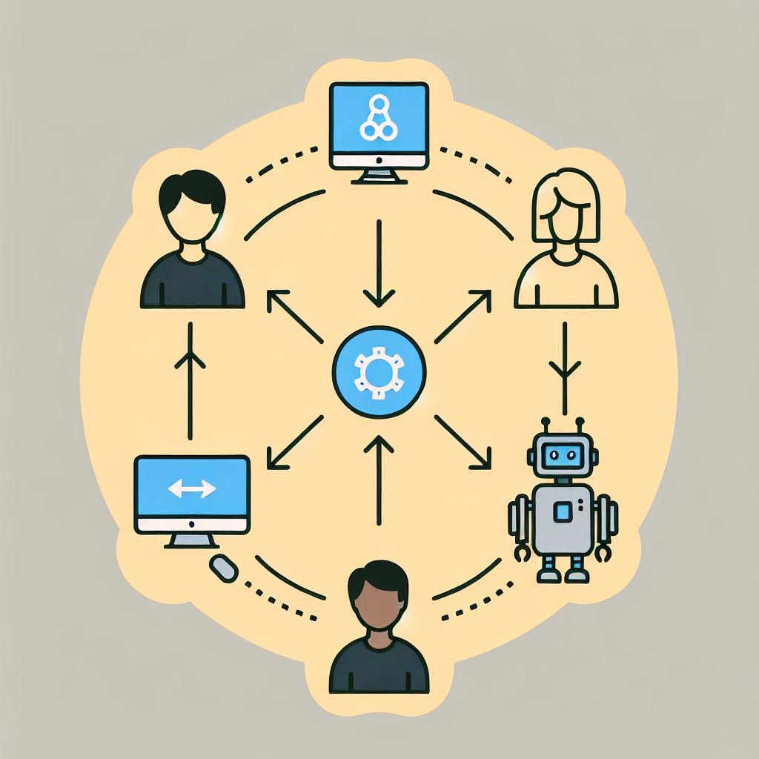
What does ROS do?
ROS is sometimes called a meta operating system because it performs many functions of an operating system, but it requires a computer's operating system such as Linux
One of the main purposes of ROS is to provide communication between the user, the computer's operating system, and equipment external to the computer
sensors, cameras, as well as robots

Slide 4
What does ROS do?
The benefit of ROS is the hardware abstraction and its ability to control a robot without the user having to know all of the details of the robot
ROS is an open source robotic software system that can be used without licensing fees
In addition to the large group of ROS researchers, there is a ROS-Industrial group dedicated to applying ROS software to robots for manufacturing
Notes:
ROS is an open source robotic software system that can be used without licensing fees by universities, government agencies, and commercial companies.
These packages are supported by the Open Source Robotics Foundation (OSRF),
http://www.ros.org/about-ros/

Slide 5

Are there “Alternatives” to ROS?
YARP
LCM
Drake
Player
Orocos
MRPT
and many others!
Notes:
ROS is an open source robotic software system that can be usedwithout licensing fees by universities, government agencies, and commercial companies.
These packages are supported by the Open Source Robotics Foundation (OSRF),
http://www.ros.org/about-ros/

Slide 6
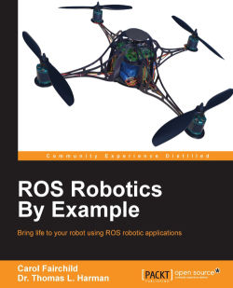
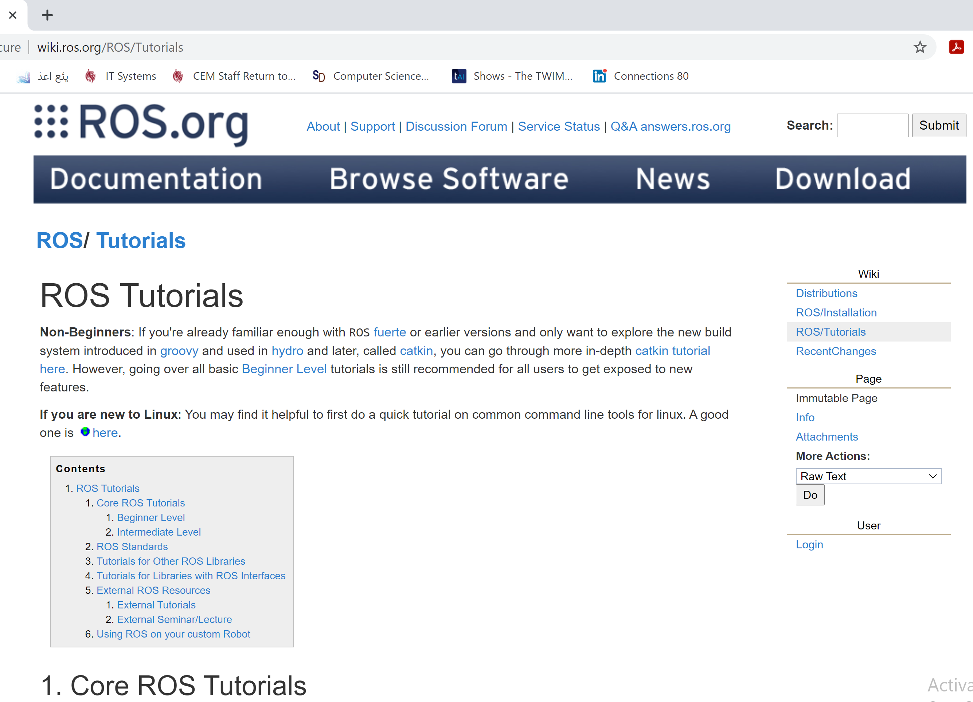
Why are we using ROS ?
It is close to an “industry standard”, and it has stability
There are reliable resources (online teaching resources)
http://wiki.ros.org/ROS/Tutorials

Slide 7
Who does control ROS ?
These packages are supported by the Open Source Robotics Foundation (OSRF), a nonprofit organization.
The distributions are updated periodically and given different names by the ROS organization.
More details about the ROS organization are available at:
http://www.ros.org/
http://wiki.ros.org/ROS/Installation
[1] By ROS Robotics By Example Carol Fairchild , Dr. Thomas L. Harman

Slide 8
ROS Nodes
Robots could be a very complex system with a high number of moving parts
ROS deals with the complexity with modularity
A software for a robot could be divided into individual modules or components using ROS
The ROS modules called nodes
Nodes represent executable code and the code can reside entirely on one computer, or nodes can be distributed between computers or between computers and robots
The advantage of this distributed structure is that each node can control one aspect of a system
One node can capture and output camera images, and another node can control a robot's manipulator in response to the camera view
ROS Robotics By Example,
by Fairchild, Carol; Harman, Thomas L
Notes:
ROS Robotics By Example
by Fairchild, Carol;
Harman, Thomas L

Slide 9
ROS Nodes
The ROS design idea is that each node is an independent module that interacts with other nodes using the ROS communication capability
The nodes can be created in various ways
From a terminal window a node can be created directly by typing a command
nodes can be created as part of a program written in Python or C++
How do nodes interact with each other?
Node2
Node1
Node3
Notes:
ROS Robotics By Example
by Fairchild, Carol;
Harman, Thomas L

Slide 10
Nodes can publish and subscribe
A node can independently execute code to perform its task but can communicate with other nodes by sending or receiving messages
The messages can consist of data, or commands, or other information necessary for the application
We define “topics” where components can broadcast information to anyone listening
Each node can:
Publish: send messages to a topic regardless of whether someone is listening or not
Some nodes provide information for other nodes, as a camera feed would do, for example
Subscribe: receive messages on a topic if anyone is sending them regardless of who
Notes:
One of the strengths of ROS is that a particular task, such as controlling a wheeled mobile robot, can be separated into a series of simpler tasks.
The tasks can include the perception of the environment using a camera or laser scanner, map making, planning a route, monitoring the battery level of the robot's battery, and controlling the motors driving the wheels of the robot.
Each of these actions might consist of a ROS node or series of nodes to accomplish the specific tasks.

Slide 11
Nodes can publish and subscribe
Subscribs
Topic
Node 2
Publishes
Node 1
Message
Message
Message
Node 3
Subscribss

Slide 12
Messages
Nodes communicate with each other by publishing simple data structures to topics. These data structures are called messages
A message is defined by field types and field names:
int32 x
More complex field types can also be defined for specific application
A sensor packet node publishes sensor data as an array of a user-defined SensorData object
This message could have the following fields:
time stamp
SensorData[] sensors
uint32 length
In this case SensorData is a user-defined field type and the empty bracket [] is appended to indicate that field is an array of SensorType objects
Notes:
where int32 is the eld type and x/y is the eld name.

Slide 13
Camera publisher node
Topic:
camera/image_raw
Publishes
Subscribs
Node 1:
Camera
Message
Node 2:
Shows on monitor
Message
A camera node can publish the image on the camera/image_raw topic
Image data from the camera/image_raw topic can be used by a node that shows the image on the computer screen
The node that receives the information is said to subscribe to the topic being published, i.e. camera/image_raw
In some cases, a node can both publish and subscribe to one or more topics

Slide 14
ROS Master
The ROS nodes are typically small and independent programs that can run concurrently on several systems
Communication is established between the nodes by the ROS Master
The ROS Master provides naming and registration services to the nodes in the ROS system
to enable individual ROS nodes to locate one another
Once these nodes are able to locate one another, they can communicate with each other peer-to-peer
Messages do NOT go through Master (i.e. peer-to-peer)
Notes:
The most often used protocol for connection is the standard Transmission Control
Protocol/Internet Protocol (TCP/IP) or Internet Protocol called TCPROS in ROS.

Slide 15
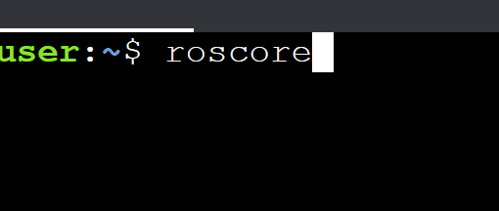
Invoking the ROS Master
Issue the following command to start the Master in a new terminal window:
$ roscore
roscore is a collection of nodes and programs that you must have run to start ROS and create the Master
so that nodes can register with the Master and can communicate

Slide 16
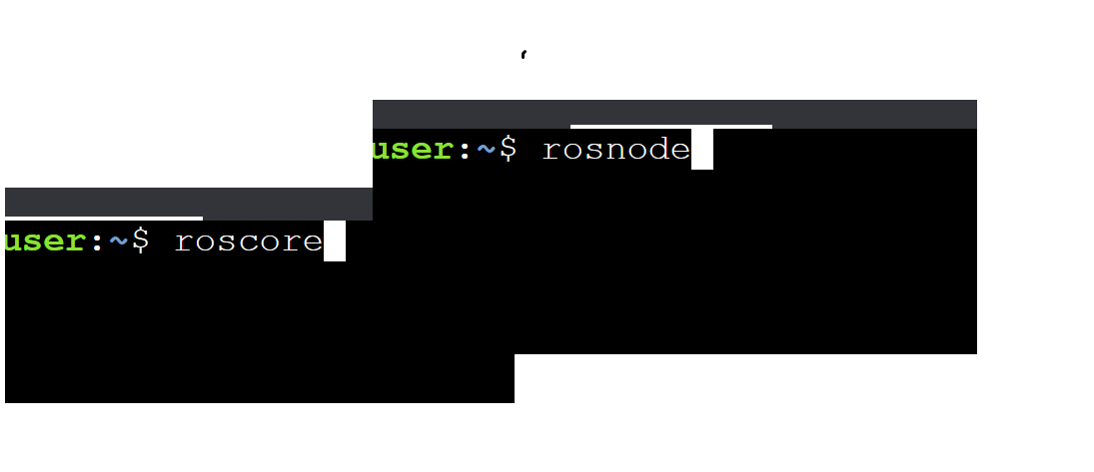
ROS commands to determine the nodes and Topics
Three commands used extensively in ROS are as follows:
roscore to start the Master and allow nodes to communicate
rosnode list to list the active nodes
rostopic list to list the topics associated with ROS nodes
Notes:
The most often used protocol for connection is the standard Transmission Control
Protocol/Internet Protocol (TCP/IP) or Internet Protocol called TCPROS in ROS.

Slide 17
ROS packages
The ROS software is divided into packages that can contain various types of programs, images, data, and even tutorials
The specific contents depend on the application for the package
A package can contain programs written in Python or C++ to control a robot or another device
Can contain code for multiple nodes
The site http://wiki.ros.org/Packages discusses ROS packages

Slide 18
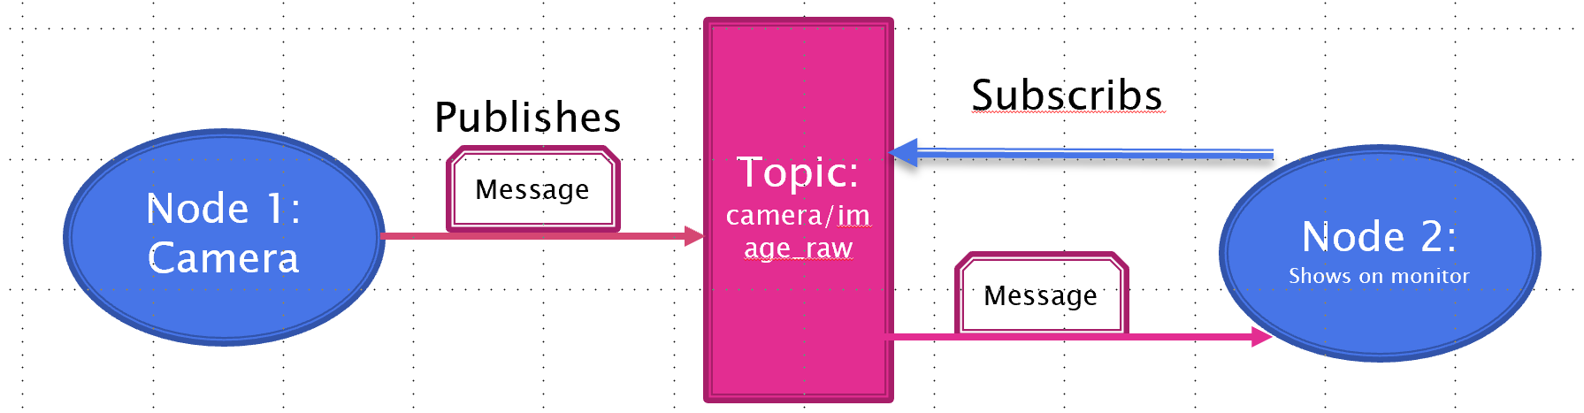
Class activity (1)
In small groups discuse about the concepts that you have learnt about ROS
Nodes
Messages
Topics
ROS Master
ROS package

Slide 19
Lesson 2 – Part 2 Robot Operating System (ROS)
AI for Mobile Robots - CSIP5202:
Intelligent Mobile Robotics (IMR)
Dr. Aboozar Taherkhani (PhD)
email: aboozar.taherkhani@dmu.ac.uk

Slide 20
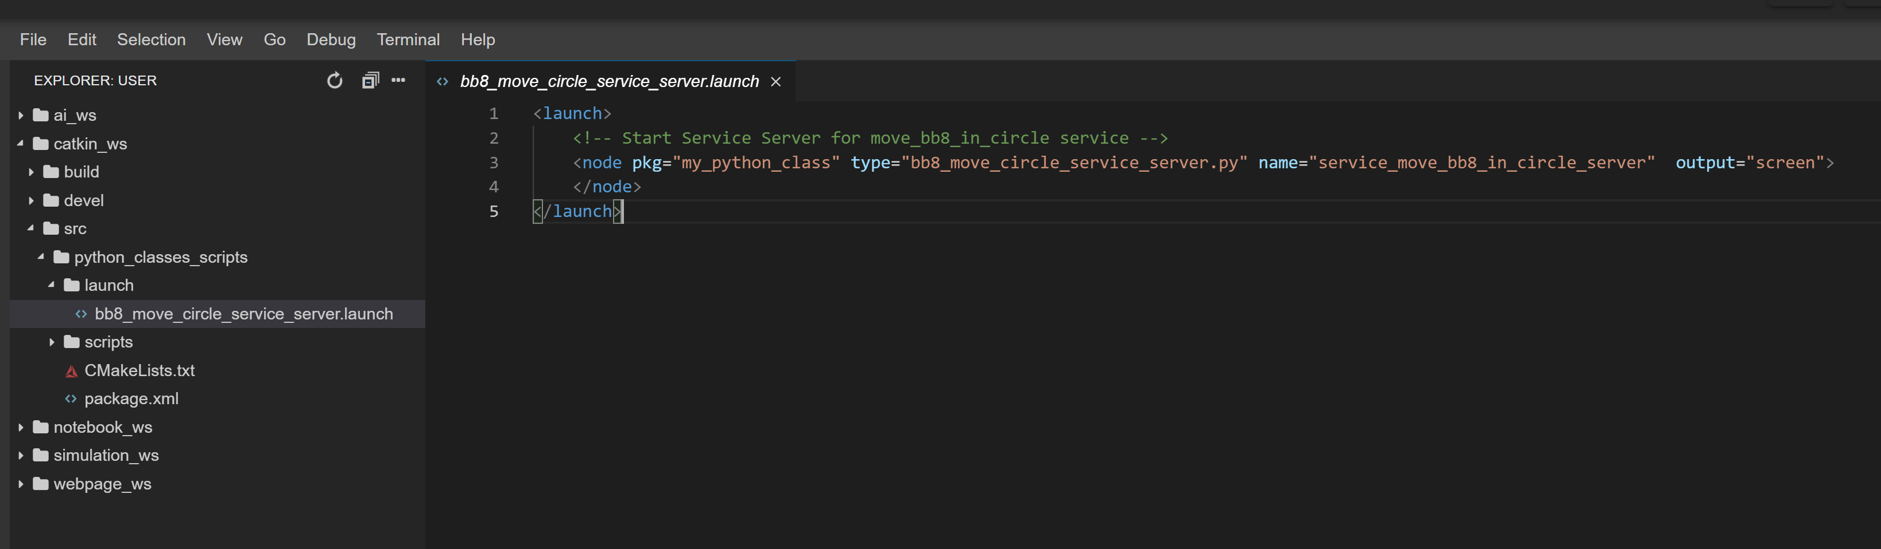
ROS Development Environment: Lunch files
As a robot project grows in scale, the number of nodes and configuration files grows very quickly. In practice, it could be very cumbersome to manually start up each individual node.
Launch files are .launch files with a specific XML format that can be placed anywhere within a package directory to initialize multiple nodes, configuration files, and a master
ROS Development Studio
Notes:
As a robot project grows in scale, the number of nodes and configuration files grow very quickly. In practice, it could be very cumbersome to manually start up each individual node. A launch file provides a convenient way to start up multiple nodes and a master, as well as set up other configurations, all at the same time.

Slide 21
ROS Development Environment: Lunch files
Launch files are required to start and end with a pair of launch tags:
<launch> ... </launch>
To start a node using a launch file the following syntax should be used within the launch file:
<node name="..." pkg="..." type="..."/>
pkg points to the package associated with the node that is to be launched
type refers to the name of the node executable file.
you can overwrite the name of the node with name argument. This will take priority over the name that is given to the node in the code.
Notes:
As a robot project grows in scale, the number of nodes and configuration files grow very quickly. In practice, it could be very cumbersome to manually start up each individual node. A launch file provides a convenient way to start up multiple nodes and a master, as well as set up other configurations, all at the same time.

Slide 22
ROS Launch Files
Simple XML files that allow you to
Launch multiple nodes at once
Set parameters for those nodes
Start Master
roslaunch <package> <file>.launch

Slide 23
ROS Launch File Example
<launch>
<!-- Start the my node -->
<node name=“myNode" pkg=“IMAT5233" type=“myCode.py“ output="screen">
<param name="rate" value="5"/>
</node>
</launch>

Slide 24
Catkin Workspace
catkin is a build system that compiles ROS packages
catkin adds support for
automatic `find package' infrastructure
building multiple, and dependent projects at the same time,
as well as supporting both C and Python
catkin should be run whenever a new project is started, or if there are any additions to packages.
Notes:
A build system is a relatively simple functional program that takes code as input and produces deployable software as output. ... The most important function of a build system is to compile source code

Slide 25
Catkin Workspace
catkin should be run whenever a new project is started, or if there are any addition to packages.
catkin is run by creating a directory called catkin_ws and then running the compile command catkin_make in that directory:
mkdir -p ~/catkin_ws/src # builds the catkin_ws in the home directory
cd ~/catkin_ws # change current directory to catkin_ws
catkin_make # run catkin
Notes:
Once the catkin workspace is compiled, your directory automatically contains CMakeLists.txt and package.xml.

Slide 26
Debugging
Robot programming requires a lot of debugging. There are a few ways to debug your robot software, including (but not limited to):
rostopic monitors ROS topics in the command line
rospy.loginfo() starts a background process that writes ROS messages to a ROS logger, viewable through a program such as rqt_console
rosbag provides a convenient way to record a number of topics for playback
rosbag record <topic>
rosbag play file.bag
pdb is extremely useful in debugging python scripts
import pdb
pdb.set_trace()
Notes:
Once the catkin workspace is compiled, your directory automatically contains CMakeLists.txt and package.xml.

Slide 27
Gazebo
Gazebo is a popular 3D dynamic simulator with the ability to accurately simulate robots in complex environments
Gazebo can be used in any stage of robot development, from testing algorithms to running regression testing in realistic scenarios
http://gazebosim.org/tutorials?cat=guided_b&tut=guided_b1
Notes:
http://gazebosim.org/tutorials?cat=guided_b&tut=guided_b1

Slide 28
Summary
Four primary components of ROS:
Nodes: the universal name for the individual components or modules that need to send or receive information
Messages: the object for holding information that needs communicated between nodes
Topics: the virtual “chat rooms" where messages are shared
Master: the “conductor" that organizes the nodes and topics
Ros package
Features in ROS Development Environment
Lunch file

Slide 29
Reference
ROS Robotics By Example
By Carol Fairchild, Dr. Thomas L. Harman
The pdf of the book is available on DMU library::
https://dmu.summon.serialssolutions.com/?s.q=ROS+Robotics+By+Example&s.cmd=#!/search?ho=t&l=en-UK&q=ROS%20by%20example

